Slide 1
Cooperating Processes ( Concurrent )
Independent process cannot affect or be affected by the execution of another process ( Does not share any data (Temp or Persistent ))
Cooperating process can affect or be affected by the execution of another process
Advantages of process cooperation
  Information sharing ( Shared files )
  Computation speed-up ( CPU or I/O Channels)
  Modularity
  Convenience

Slide 2
Producer-Consumer Problem
Paradigm for cooperating processes, producer process produces information that is consumed by a consumer process.
  unbounded-buffer places no practical limit on the size of the buffer.
  bounded-buffer assumes that there is a fixed buffer size. ( Consumer must wait if the Buffer is empty and producer must wait if the buffer is full )

Slide 3
Bounded-Buffer – Shared-Memory Solution
Shared data
      #define BUFFER_SIZE 10
      Typedef struct {
      . . .
      } item;
      item buffer[BUFFER_SIZE];
      int in = 0;
      int out = 0;
Solution is correct, but can only use BUFFER_SIZE-1 elements

Slide 4
Bounded-Buffer – Producer Process
item nextProduced;
while (1) {
while (((in + 1) % BUFFER_SIZE) == out) //Buffer full
; /* do nothing */
buffer[in] = nextProduced;
in = (in + 1) % BUFFER_SIZE;
}

Slide 5
Bounded-Buffer – Consumer Process
item nextConsumed;
while (1) {
while (in == out) // Empty
; /* do nothing */
nextConsumed = buffer[out];
out = (out + 1) % BUFFER_SIZE;
}

Slide 6
Interprocess Communication (IPC)
Mechanism for processes to communicate and to synchronize their actions.
Message system – processes communicate with each other without resorting to shared variables.
IPC facility provides two operations:
  send(message) – message size fixed or variable
  receive(message)
If P and Q wish to communicate, they need to:
  establish a communication link between them
  exchange messages via send/receive
Implementation of communication link
  physical (e.g., shared memory, hardware bus)
  logical (e.g., logical properties)

Slide 7
Implementation Questions
How are links established?
Can a link be associated with more than two processes?
How many links can there be between every pair of communicating processes?
What is the capacity of a link?
Is the size of a message that the link can accommodate fixed or variable?
Is a link unidirectional or bi-directional?

Slide 8
Addressing
Sending process need to be able to specify which process should receive the message
  Direct addressing
  Indirect Addressing
Notes:
it is necessary to have a way of specifying in the send primitive which process is to receive the message.
Similarly, most implementations allow a receiving process to indicate the source of a message to be received.
8

Slide 9
Direct Communication
Send primitive includes a specific identifier of the destination process
Receive primitive could know ahead of time which process a message is expected
Receive primitive could use source parameter to return a value when the receive operation has been performed

Slide 10
Direct Communication…
Processes must name each other explicitly:
  send (P, message) – send a message to process P
  receive(Q, message) – receive a message from process Q
Properties of communication link
  Links are established automatically.
  A link is associated with exactly one pair of communicating processes.
  Between each pair there exists exactly one link.
  The link may be unidirectional, but is usually bi-directional.

Slide 11
Indirect Communication
Messages are directed and received from mailboxes (also referred to as ports).
  Each mailbox has a unique id.
  Processes can communicate only if they share a mailbox.
Properties of communication link
  Link established only if processes share a common mailbox
  A link may be associated with many processes.
  Each pair of processes may share several communication links.
  Link may be unidirectional or bi-directional.

Slide 12
Indirect Communication
Operations
  create a new mailbox
  send and receive messages through mailbox
  destroy a mailbox
Primitives are defined as:
send(A, message) – send a message to mailbox A
receive(A, message) – receive a message from mailbox A

Slide 13
Indirect Communication
Mailbox sharing
  P₁, P₂, and P₃ share mailbox A.
  P₁, sends; P₂ and P₃ receive.
  Who gets the message?
Solutions
  Allow a link to be associated with at most two processes.
  Allow only one process at a time to execute a receive operation.
  Allow the system to select arbitrarily the receiver ( either p2 or p3 ). Sender is notified who the receiver was.

Slide 14
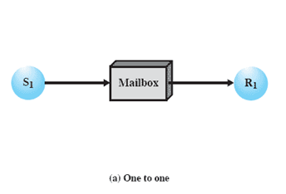
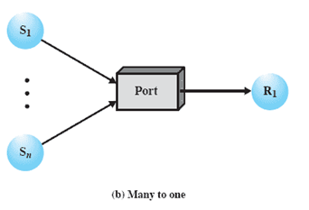
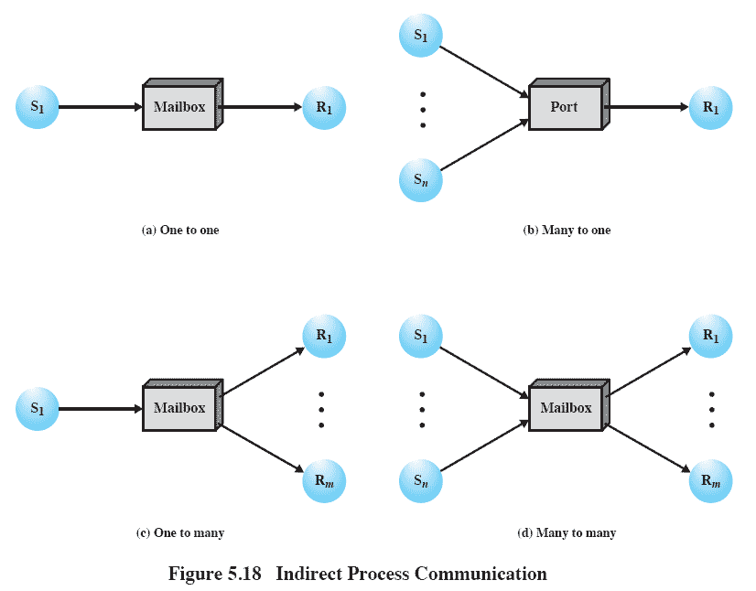
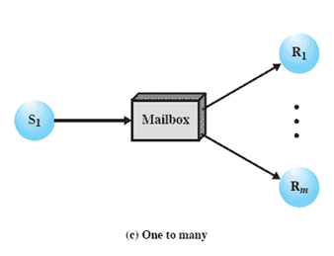
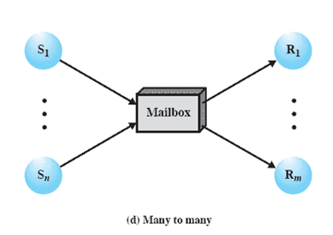
Indirect Process Communication
Notes:
Animated Slide – each item below is magnified for instructor to address separately
1) A one-to-one relationship
allows a private communications link to be set up between two processes.
This insulates their interaction from erroneous interference from other processes.
2) A many-to-one relationship is useful for client/server interaction;
one process provides service to a number of other processes.
In this case, the mailbox is often referred to as a port.
3) A one-to-many relationship allows for one sender and multiple receivers;
it is useful for applications where a message or some information is to be broadcast to a set of processes.
4) A many-to-many relationship
allows multiple server processes to provide concurrent service to multiple clients.
The association of processes to mailboxes can be either static or dynamic.
Ports are often statically associated with a particular process; that is, the port is created and assigned to the process permanently.
Similarly, a one-to-one relationship is typically defined statically and permanently. When there are many senders, the association of a sender to a mailbox may occur dynamically. Primitives such as connect and disconnect may be used for this purpose
14

Slide 15
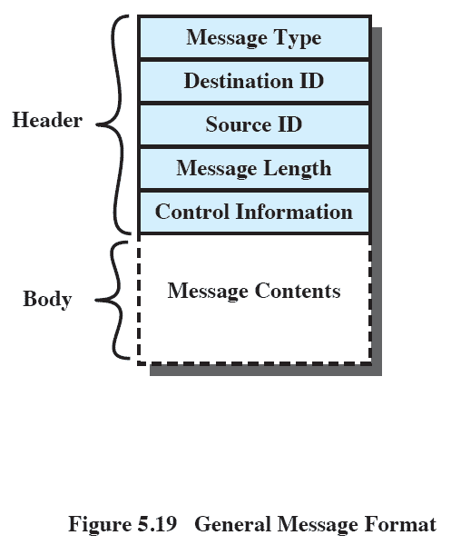
General Message Format
Notes:
The format of the message depends on the objectives of the messaging facility and whether the facility runs on a single computer or on a distributed system.
This is a typical message format for operating systems that support variable-length messages.
The message is divided into two parts:
a header, which contains information about the message.
The header may contain an identification of the source and intended destination of the message, a length field, and a type field to discriminate among various types of messages.
additional control information, e.g. pointer field so a linked list of messages can be created; a sequence number, to keep track of the number and order of messages passed between source and destination; and a priority field.
a body, which contains the actual contents of the message.
15

Slide 16
Synchronization
Message passing may be either blocking or non-blocking.
Blocking is considered synchronous
Non-blocking is considered asynchronous
send and receive primitives may be either blocking or non-blocking.

Slide 17
Synchronization conti…
Blocking Send: the sending process is blocked until the message is received by the receiving process or by mailbox.
Non blocking Send: the sending process sends the message and resumes the operation.
Blocking receive: the receiver blocks until a message is available.
Non blocking receive: the receiver retrieves either a valid message or Null.

Slide 18
Buffering
Queue of messages attached to the link; implemented in one of three ways.
  1. Zero capacity – 0 messages
  Sender must wait for receiver (rendezvous).
  2. Bounded capacity – finite length of n messages
  Sender must wait if link full.
  3. Unbounded capacity – infinite length
  Sender never waits.

Slide 19
Background
Concurrent access to shared data may result in data inconsistency.
Maintaining data consistency requires mechanisms to ensure the orderly execution of cooperating processes.
Shared-memory solution to bounded-buffer problem allows at most n – 1 items in buffer at the same time. A solution, where all N buffers are used is not simple.
  Suppose that we modify the producer-consumer code by adding a variable counter, initialized to 0 and incremented each time a new item is added to the buffer

Slide 20
Bounded-Buffer
Shared data
      #define BUFFER_SIZE 10
      typedef struct {
      . . .
      } item;
      item buffer[BUFFER_SIZE];
      int in = 0;
      int out = 0;
      int counter = 0;

Slide 21
Bounded-Buffer
Producer process
item nextProduced;
while (1) {
while (counter == BUFFER_SIZE)
; /* do nothing */
buffer[in] = nextProduced;
in = (in + 1) % BUFFER_SIZE;
counter++;
}

Slide 22
Bounded-Buffer
Consumer process
item nextConsumed;
while (1) {
while (counter == 0)
; /* do nothing */
nextConsumed = buffer[out];
out = (out + 1) % BUFFER_SIZE;
counter--;
}

Slide 23
Bounded Buffer
The statements
counter++;
counter--;
must be performed atomically.
Atomic operation means an operation that completes in its entirety without interruption.

Slide 24
Bounded Buffer
The statement “count++” may be implemented in machine language as:
register1 = counter
register1 = register1 + 1
counter = register1
The statement “count--” may be implemented as:
register2 = counter
register2 = register2 – 1
counter = register2

Slide 25
Bounded Buffer
If both the producer and consumer attempt to update the buffer concurrently, the assembly language statements may get interleaved.
Interleaving depends upon how the producer and consumer processes are scheduled.

Slide 26
Bounded Buffer
Assume counter is initially 5. One interleaving of statements is:
producer: register1 = counter (register1 = 5)
producer: register1 = register1 + 1 (register1 = 6)
consumer: register2 = counter (register2 = 5)
consumer: register2 = register2 – 1 (register2 = 4)
producer: counter = register1 (counter = 6)
consumer: counter = register2 (counter = 4)
The value of count may be either 4 or 6, where the correct result should be 5.

Slide 27
Race Condition
Race condition: The situation where several processes access – and manipulate shared data concurrently. The final value of the shared data depends upon which process finishes last.
To prevent race conditions, concurrent processes must be synchronized.

Slide 28
The Critical-Section Problem
n processes all competing to use some shared data
Each process has a code segment, called critical section, in which the shared data is accessed.
Problem – ensure that when one process is executing in its critical section, no other process is allowed to execute in its critical section.

Slide 29
Solution to Critical-Section Problem
1. Mutual Exclusion. If process P_{i} is executing in its critical section, then no other processes can be executing in their critical sections.
2. Progress. If no process is executing in its critical section and there exist some processes that wish to enter their critical section, then the selection of the processes that will enter the critical section next cannot be postponed indefinitely.
3. Bounded Waiting. A bound must exist on the number of times that other processes are allowed to enter their critical sections after a process has made a request to enter its critical section and before that request is granted.
  Assume that each process executes at a nonzero speed
  No assumption concerning relative speed of the n processes.

Slide 30
Initial Attempts to Solve Problem
Only 2 processes, P₀ and P₁
General structure of process P_{i} (other process P_{j})
do {
entry section
critical section
exit section
reminder section
} while (1);
Processes may share some common variables to synchronize their actions.

Slide 31
Algorithm 1
Shared variables:
  int turn;
  initially turn = 0
  turn - i ⇒ P_{i} can enter its critical section
Process P_{i}
do {
while (turn != i) ;/* Do Skip */
critical section
turn = j;
reminder section
} while (1);
Satisfies mutual exclusion, but not progress

Slide 32
Algorithm 2
Shared variables
  boolean flag[2];
  initially flag [0] = flag [1] = false.
  flag [i] = true ⇒ P_{i} ready to enter its critical section
Process P_{i}
do {
flag[i] := true;
while (flag[j]) ; critical section
flag [i] = false;
remainder section
} while (1);
Satisfies mutual exclusion, but not progress requirement.

Slide 33
Algorithm 3 (Peterson’s)
Combined shared variables of algorithms 1 and 2.
Process P_{i}
do {
flag [i]:= true;
turn = j;
while (flag [j] && turn = j) ;
critical section
flag [i] = false;
remainder section
} while (1);
Meets all three requirements; solves the critical-section problem for two processes.

Slide 34
Bakery Algorithm
Critical section for n processes
Before entering its critical section, process receives a number. Holder of the smallest number enters the critical section.
If processes P_{i} and P_{j} receive the same number, if i < j, then P_{i} is served first; else P_{j} is served first.
The numbering scheme always generates numbers in increasing order of enumeration; i.e., 1,2,3,3,3,3,4,5...
Applications:
Bakeries, Ice-cream stores, Deli counters and Motor-Registries etc:

Slide 35
Bakery Algorithm
Notation <≡ lexicographical order (ticket #, process id #)
  (a,b) < c,d) if a < c or if a = c and b < d
  max (a₀,…, a_{n-1}) is a number, k, such that k ≥ a_{i} for i - 0,
  …, n – 1
Shared data
boolean choosing[n];
int number[n];
Data structures are initialized to false and 0 respectively

Slide 36
Bakery Algorithm
do {
choosing[i] = true;
number[i] = max(number[0], number[1], …, number [n – 1])+1;
choosing[i] = false;
for (j = 0; j < n; j++) {
while (choosing[j]) ;
while ((number[j] != 0) && (number[j,j] < number[i,i])) ;
}
critical section
number[i] = 0;
remainder section
} while (1);

Slide 37
Synchronization Hardware
Test and modify the content of a word atomically
.
boolean TestAndSet(boolean &target) {
boolean rv = target;
target = true;
return rv;
}

Slide 38
Mutual Exclusion with Test-and-Set
Shared data:
boolean lock = false;
Process P_{i}
do {
while (TestAndSet(lock)) ;
critical section
lock = false;
remainder section
}

Slide 39
Synchronization Hardware
Atomically swap two variables.
void Swap(boolean &a, boolean &b) {
boolean temp = a;
a = b;
b = temp;
}

Slide 40
Mutual Exclusion with Swap
Shared data (initialized to false):
boolean lock;
  boolean waiting[n];
Process P_{i}
do {
key = true;
while (key == true)
Swap(lock,key);
critical section
lock = false;
remainder section
}

Slide 41
Hardware Mutual
Exclusion: Advantages
Applicable to any number of processes on either a single processor or multiple processors sharing main memory
It is simple and therefore easy to verify
It can be used to support multiple critical sections
Notes:
41

Slide 42
Hardware Mutual
Exclusion: Disadvantages
Busy-waiting consumes processor time
Starvation is possible when a process leaves a critical section and more than one process is waiting.
  Some process could indefinitely be denied access.
Deadlock is possible
Notes:
Busy waiting
While a process is waiting for access to a critical section, it continues to consume processor time.
Starvation is possible.
When a process leaves a critical section and more than one process is waiting, the selection of a waiting process is arbitrary.
Thus, some process could indefinitely be denied access.
Deadlock is possible.
Example (on a uniprocessor).
Process P1 executes the special instruction (e.g., compare&swap, exchange) and enters its critical section.
P1 is then interrupted to give the processor to P2, which has higher priority.
If P2 now attempts to use the same resource as P1, it will be denied access because of the mutual exclusion mechanism.
Thus it will go into a busy waiting loop.
However, P1 will never be dispatched because it is of lower priority than another ready process, P2.
42

Slide 43
Semaphores
Synchronization tool that does not require busy waiting.
Semaphore S – integer variable
can only be accessed via two indivisible (atomic) operations
P: wait (S):
while S≤ 0 do no-op;
S--;
V: signal (S):
S++;

Slide 44
Semaphore
Fundamental principle of this design mechanism:
Two or more processes can cooperate by means of simple signals, such that a process can be forced to stop at a specified place until it has received a specific signal.
Notes:
Complex coordination between processes can be satisfied by building a correct structure of such signals. For signalling, special values called SEMAPHORES are used.
44

Slide 45
Semaphore
Semaphore:
  An integer value used for signalling among processes.
Only three operations may be performed on a semaphore, all of which are atomic:
  initialize,
  Decrement (semWait)
  increment. (semSignal)
Notes:
1. A semaphore may be initialized to a nonnegative integer value.
2. The semWait operation decrements the semaphore value.
If the value becomes negative, then the process executing the semWait is blocked.
Otherwise, the process continues execution.
3. The semSignal operation increments the semaphore value.
If the resulting value is less than or equal to zero, then a process blocked by a semWait operation, if any, is unblocked.
45

Slide 46
Critical Section of n Processes
Shared data:
semaphore mutex; //initially mutex = 1
Process Pi:
do {
wait(mutex); //wait (S):
//P:while S≤ 0 do no-op // S--;
critical section
signal(mutex);
V: signal (S):
//S++;
remainder section
} while (1
problem for real multiprogramming systems ( Due to busy waiting )

Slide 47
Semaphore Implementation( To avoid Busy waiting Problem)
Define a semaphore as a record
typedef struct {
int value;
struct process *L;
} semaphore;
Assume two simple operations:
  block suspends the process that invokes it.
  wakeup(P) resumes the execution of a blocked process P.

Slide 48
Implementation ( To avoid Busy waiting Problem)
Semaphore operations now defined as
wait(S):
S.value--;
if (S.value < 0) {
add this process to S.L;
block;
}
signal(S):
S.value++;
if (S.value <= 0) {
remove a process P from S.L;
wakeup(P);
}

Slide 49
Semaphore as a General Synchronization Tool
Execute B in P_{j} only after A executed in P_{i}
Use semaphore flag initialized to 0
Code:
P_{i} P_{j}
 
A wait(flag)
signal(flag) B

Slide 50
Deadlock and Starvation
Deadlock – two or more processes are waiting indefinitely for an event that can be caused by only one of the waiting processes.
Let S and Q be two semaphores initialized to 1
P₀ P₁
wait(S); wait(Q);
wait(Q); wait(S);
 
signal(S); signal(Q);
signal(Q) signal(S);
Starvation – indefinite blocking. A process may never be removed from the semaphore queue in which it is suspended.

Slide 51
Two Types of Semaphores
Counting semaphore – integer value can range over an unrestricted domain.
Binary semaphore – integer value can range only between 0 and 1; can be simpler to implement.
Can implement a counting semaphore S as a binary semaphore.

Slide 52
Implementing S as a Binary Semaphore
Data structures:
binary-semaphore S1, S2;
int C:
Initialization:
S1 = 1
S2 = 0
C = initial value of semaphore S

Slide 53
Implementing S
wait operation
wait(S1);
C--;
if (C < 0) {
signal(S1);
wait(S2);
}
signal(S1);
signal operation
  wait(S1);
  C ++;
  if (C <= 0)
  signal(S2);
  else
  signal(S1);

Slide 54
Classical Problems of Synchronization
Bounded-Buffer Problem
Readers and Writers Problem
Dining-Philosophers Problem

Slide 55
Bounded-Buffer Problem
Shared data
semaphore full, empty, mutex;
Initially:
full = 0, empty = n, mutex = 1

Slide 56
Bounded-Buffer Problem Producer Process
do {
…
produce an item in nextp
…
wait(empty);
wait(mutex);
…
add nextp to buffer
…
signal(mutex);
signal(full);
} while (1);

Slide 57
Bounded-Buffer Problem Consumer Process
do {
wait(full)
wait(mutex);
…
remove an item from buffer to nextc
…
signal(mutex);
signal(empty);
…
consume the item in nextc
…
} while (1);

Slide 58
Readers-Writers Problem
S hared data
semaphore mutex, wrt;
Initially
mutex = 1, wrt = 1, readcount = 0

Slide 59
Readers-Writers Problem Writer Process
wait(wrt);
…
writing is performed
…
signal(wrt);

Slide 60
Readers-Writers Problem Reader Process
wait(mutex);
readcount++;
if (readcount == 1)
wait(wrt);
signal(mutex);
…
reading is performed
…
wait(mutex);
readcount--;
if (readcount == 0)
signal(wrt);
signal(mutex):

Slide 61
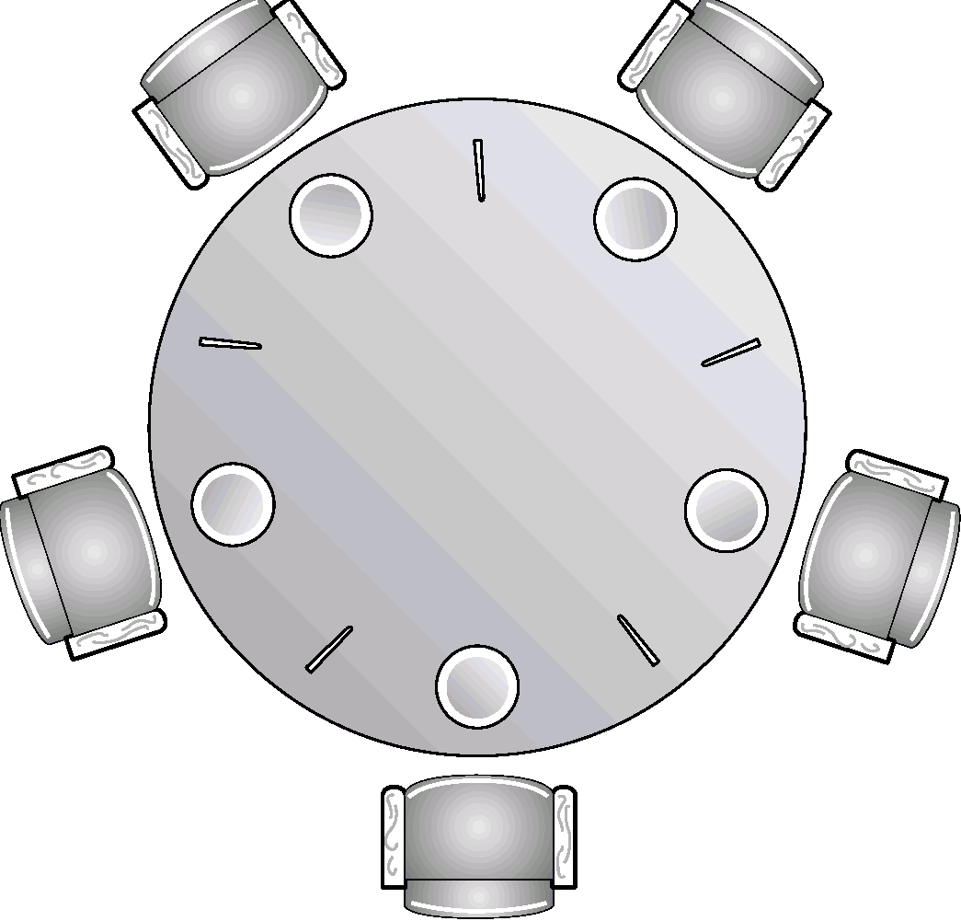
Dining-Philosophers Problem
Shared data
semaphore chopstick[5];
Initially all values are 1

Slide 62






Dining Philosopher’s Problem (Dijkstra ’71)

Slide 63
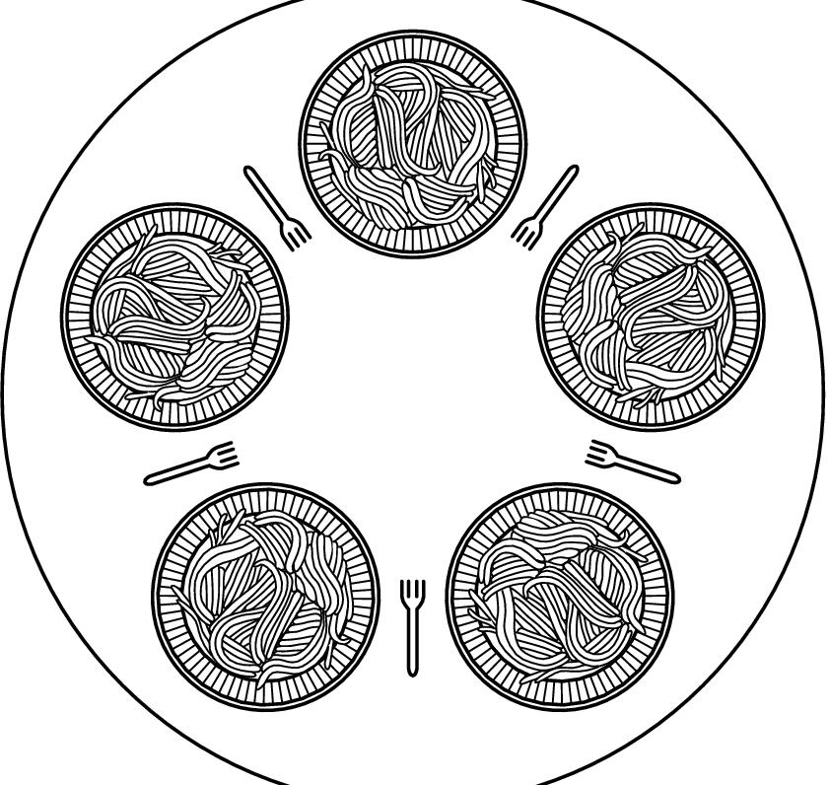
Dining Philosophers…
Philosophers eat/think
Eating needs 2 forks
Pick one fork at a time
How to prevent deadlock

Slide 64
Dining-Philosophers Problem
Philosopher i:
do {
wait(chopstick[i])
wait(chopstick[(i+1) % 5])
…
eat
…
signal(chopstick[i]);
signal(chopstick[(i+1) % 5]);
…
think
…
} while (1);

Slide 65
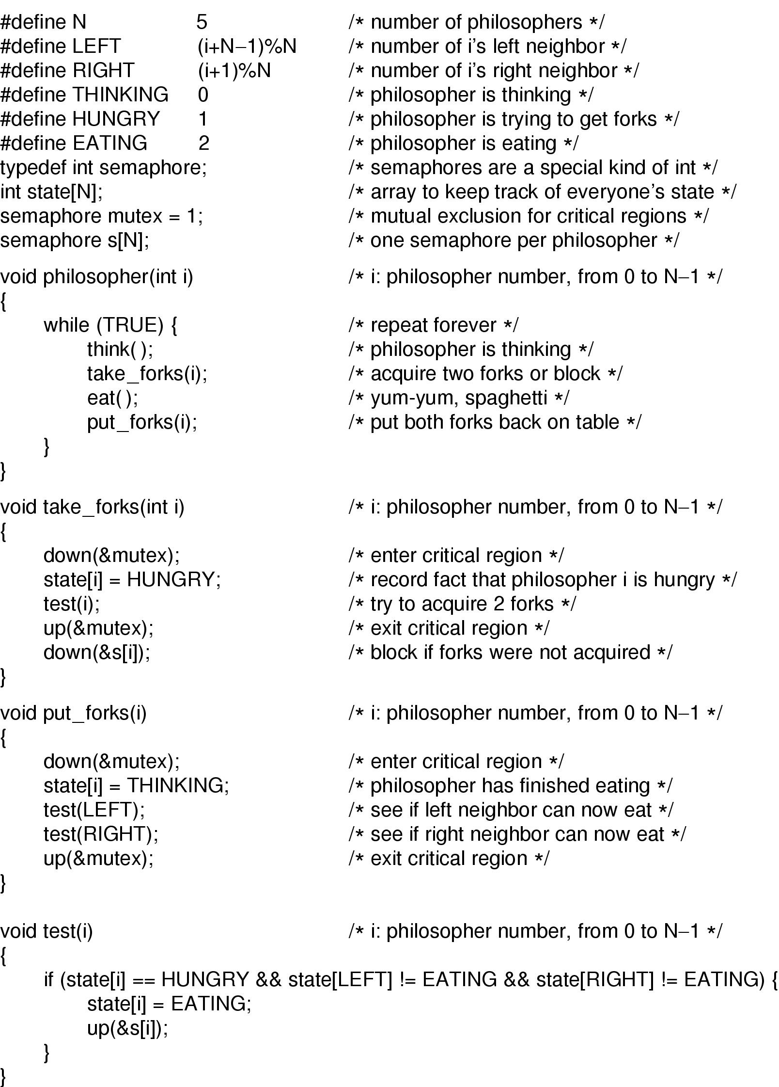
Dining Philosophers
Solution to dining philosophers problem (part 1)

Slide 66
Dining Philosophers
Solution to dining philosophers problem (part 2)

Slide 67
Critical Regions
High-level synchronization construct
A shared variable v of type T, is declared as:
v: shared T
Variable v accessed only inside statement
region v when B do S
where B is a boolean expression.
While statement S is being executed, no other process can access variable v.

Slide 68
Critical Regions
Regions referring to the same shared variable exclude each other in time.
When a process tries to execute the region statement, the Boolean expression B is evaluated. If B is true, statement S is executed. If it is false, the process is delayed until B becomes true and no other process is in the region associated with v.

Slide 69
Example – Bounded Buffer
Shared data:
struct buffer {
int pool[n];
int count, in, out;
}

Slide 70
Bounded Buffer Producer Process
Producer process inserts nextp into the shared buffer
region buffer when( count < n) {
pool[in] = nextp;
in:= (in+1) % n;
count++;
}

Slide 71
Bounded Buffer Consumer Process
Consumer process removes an item from the shared buffer and puts it in nextc
region buffer when (count > 0) { nextc = pool[out];
out = (out+1) % n;
count--;
}

Slide 72
Implementation region x when B do S
Associate with the shared variable x, the following variables:
semaphore mutex, first-delay, second-delay;
int first-count, second-count;
Mutually exclusive access to the critical section is provided by mutex.
If a process cannot enter the critical section because the Boolean expression B is false, it initially waits on the first-delay semaphore; moved to the second-delay semaphore before it is allowed to reevaluate B.

Slide 73
Implementation
Keep track of the number of processes waiting on first-delay and second-delay, with first-count and second-count respectively.
The algorithm assumes a FIFO ordering in the queuing of processes for a semaphore.
For an arbitrary queuing discipline, a more complicated implementation is required.

Slide 74
Monitors
High-level synchronization construct that allows the safe sharing of an abstract data type among concurrent processes.
monitor monitor-name
{
shared variable declarations
procedure body P1 (…) {
. . .
}
procedure body P2 (…) {
. . .
}
procedure body Pn (…) {
. . .
}
{
initialization code
}
}

Slide 75
Monitors
To allow a process to wait within the monitor, a condition variable must be declared, as
condition x, y;
Condition variable can only be used with the operations wait and signal.
  The operation
  x.wait();
  means that the process invoking this operation is suspended until another process invokes
  x.signal();
  The x.signal operation resumes exactly one suspended process. If no process is suspended, then the signal operation has no effect.

Slide 76
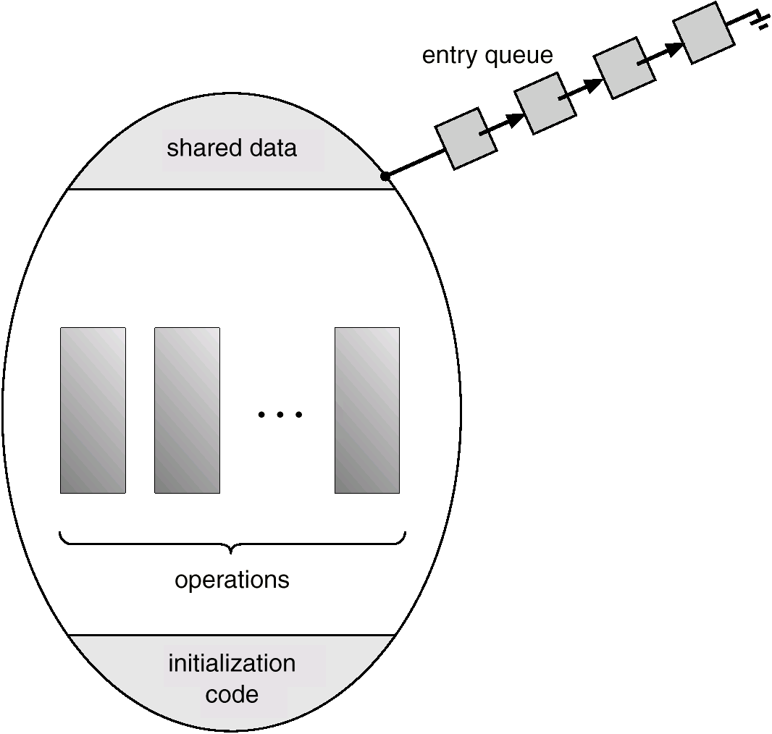
Schematic View of a Monitor

Slide 77
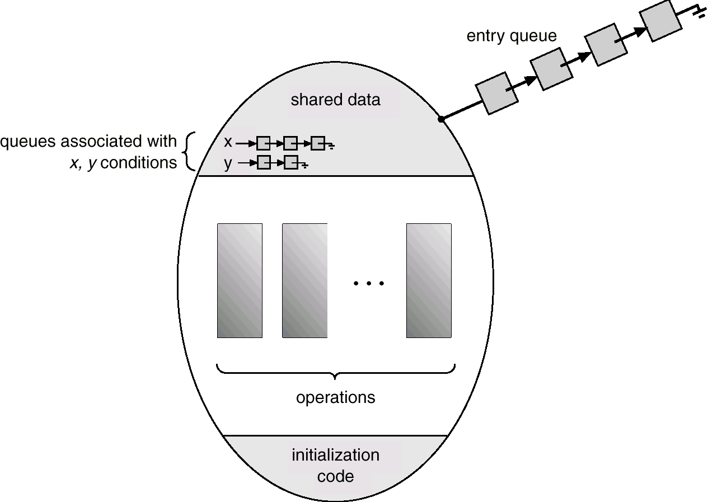
Monitor With Condition Variables

Slide 78
Dining Philosophers Example
monitor dp
{
enum {thinking, hungry, eating} state[5];
condition self[5];
void pickup(int i) // following slides
void putdown(int i) // following slides
void test(int i) // following slides
void init() {
for (int i = 0; i < 5; i++)
state[i] = thinking;
}
}

Slide 79
Dining Philosophers
void pickup(int i) {
state[i] = hungry;
test[i];
if (state[i] != eating)
self[i].wait();
}
void putdown(int i) {
state[i] = thinking;
// test left and right neighbors
test((i+4) % 5);
test((i+1) % 5);
}

Slide 80
Dining Philosophers
void test(int i) {
if ( (state[(I + 4) % 5] != eating) &&
(state[i] == hungry) &&
(state[(i + 1) % 5] != eating)) {
state[i] = eating;
self[i].signal();
}
}

Slide 81
Monitor Implementation Using Semaphores
Variables
semaphore mutex; // (initially = 1)
semaphore next; // (initially = 0)
int next-count = 0;
Each external procedure F will be replaced by
wait(mutex);
…
body of F;
…
if (next-count > 0)
signal(next)
else
signal(mutex);
Mutual exclusion within a monitor is ensured.

Slide 82
Monitor Implementation
For each condition variable x, we have:
semaphore x-sem; // (initially = 0)
int x-count = 0;
The operation x.wait can be implemented as:
x-count++;
if (next-count > 0)
signal(next);
else
signal(mutex);
wait(x-sem);
x-count--;

Slide 83
Monitor Implementation
The operation x.signal can be implemented as:
if (x-count > 0) {
next-count++;
signal(x-sem);
wait(next);
next-count--;
}

Slide 84
Monitor Implementation
Conditional-wait construct: x.wait(c);
  c – integer expression evaluated when the wait operation is executed.
  value of c (a priority number) stored with the name of the process that is suspended.
  when x.signal is executed, process with smallest associated priority number is resumed next.
Check two conditions to establish correctness of system:
  User processes must always make their calls on the monitor in a correct sequence.
  Must ensure that an uncooperative process does not ignore the mutual-exclusion gateway provided by the monitor, and try to access the shared resource directly, without using the access protocols.

Slide 85
Deadlocks
System Model
Deadlock Characterization
Methods for Handling Deadlocks
Deadlock Prevention
Deadlock Avoidance
Deadlock Detection
Recovery from Deadlock
Combined Approach to Deadlock Handling

Slide 86
The Deadlock Problem
A set of blocked processes each holding a resource and waiting to acquire a resource held by another process in the set.
Example
  System has 2 tape drives.
  P₁ and P₂ each hold one tape drive and each needs another one.
Example
  semaphores A and B, initialized to 1
        P₀ P₁
        wait (A); wait(B)
        wait (B); wait(A)

Slide 87
Bridge Crossing Example
Traffic only in one direction.
Each section of a bridge can be viewed as a resource.
If a deadlock occurs, it can be resolved if one car backs up (preempt resources and rollback).
Several cars may have to be backed up if a deadlock occurs.
Starvation is possible.

Slide 88

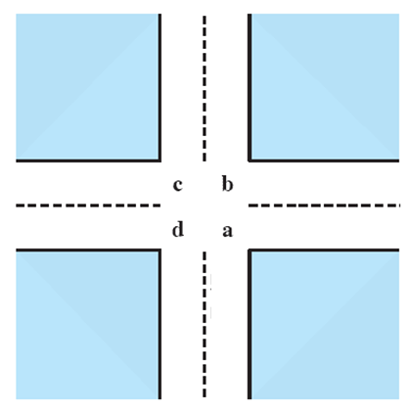
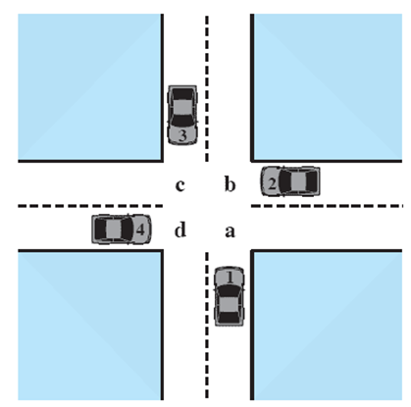



Potential Deadlock
I need quad C and B
I need quad B and C
I need quad A and B
I need quad D and A
Notes:
Animated Slide
Click 1 Cars approach intersection
Then Cars announce their resource needs
All deadlocks involve conflicting needs for resources by two or more processes. A common example is the traffic deadlock.
The typical rule of the road in the United States is that a car at a four-way stop should defer to a car immediately to its right.
This rule works if there are only two or three cars at the intersection.
If all four cars arrive at about the same time, each will refrain from entering the intersection, this causes a potential deadlock.
The deadlock is only potential, not actual, because the necessary resources are available for any of the cars to proceed.
If one car eventually does proceed, it can do so.
88

Slide 89
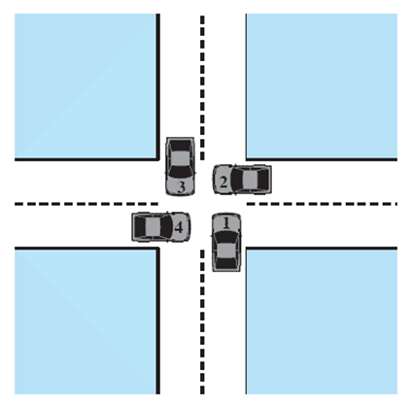
Actual Deadlock
HALT until D is free
HALT until C is free
HALT until B is free
HALT until A is free
Notes:
Animated Slide
Click 1 Cars move to deadlock
Then Cars announce their resource need
But if all four cars ignore the rules and proceed (cautiously) into the intersection at the same time, then each car seizes one resource (one quadrant) but cannot proceed because the required second resource has already been seized by another car.
This is an actual deadlock.
89

Slide 90
System Model
Resource types R₁, R₂, . . ., R_{m}
    CPU cycles, memory space, I/O devices
Each resource type R_{i} has W_{i} instances.
Each process utilizes a resource as follows:
  request
  use
  release

Slide 91
Resource Categories
Two general categories of resources:
Reusable
  can be safely used by only one process at a time and is not depleted by that use.
Consumable
  one that can be created (produced) and destroyed (consumed).

Slide 92
Reusable Resources
Such as:
  Processors, I/O channels, main and secondary memory, devices, and data structures such as files, databases, and semaphores
Deadlock occurs if each process holds one resource and requests the other
Notes:
92

Slide 93
Example of
Reuse Deadlock
Consider two processes that compete for exclusive access to a disk file D and a tape drive T.
Deadlock occurs if each process holds one resource and requests the other.

Slide 94
Example 2:
Memory Request
Space is available for allocation of 200Kbytes, and the following sequence of events occur
Deadlock occurs if both processes progress to their second request
P1
P2
. . .
. . .
Request 80 Kbytes;
Request 70 Kbytes;
. . .
. . .
Request 80 Kbytes;
Request 60 Kbytes;
Notes:
If the amount of memory to be requested is not known ahead of time, it is difficult to deal with this type of deadlock by means of system design constraints.
The best way to deal with this particular problem is, in effect, to eliminate the possibility by using virtual memory, which is discussed later (ch 8)
94

Slide 95
Consumable Resources
Such as Interrupts, signals, messages, and information in I/O buffers
Deadlock may occur if a Receive message is blocking
May take a rare combination of events to cause deadlock
Notes:
95

Slide 96
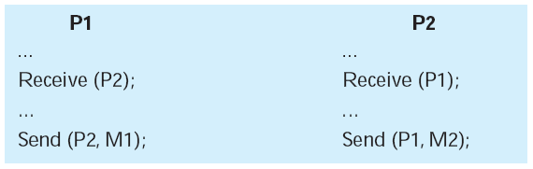
Example of Deadlock
Consider a pair of processes, in which each process attempts to receive a message from the other process and then send a message to the other process
Notes:
Deadlock occurs if the Receive is blocking (i.e., the receiving process is blocked until the message is received).
A design error is the cause of the deadlock.
Such errors may be quite subtle and difficult to detect.
Furthermore, it may take a rare combination of events to cause the deadlock; thus a program could be in use for a considerable period of time, even years, before the deadlock actually occurs.
96

Slide 97
Deadlock Characterization
Deadlock can arise if four conditions hold simultaneously.
Mutual exclusion: only one process at a time can use a resource.
Hold and wait: a process holding at least one resource is waiting to acquire additional resources held by other processes.
No preemption: a resource can be released only voluntarily by the process holding it, after that process has completed its task.
Circular wait: there exists a set {P₀, P₁, …, P₀} of waiting processes such that P₀ is waiting for a resource that is held by P₁, P₁ is waiting for a resource that is held by
P₂, …, P_{n–1} is waiting for a resource that is held by
P_{n}, and P₀ is waiting for a resource that is held by P₀.

Slide 98
Resource-Allocation Graph
A set of vertices V and a set of edges E.
V is partitioned into two types:
  P = {P₁, P₂, …, P_{n}}, the set consisting of all the processes in the system.
  R = {R₁, R₂, …, R_{m}}, the set consisting of all resource types in the system.
request edge – directed edge P_{i} → R_{j}
assignment edge – directed edge R_{j} → P_{i}

Slide 99
Resource-Allocation Graph (Cont.)
Process
Resource Type with 4 instances
P_{i} requests instance of R_{j}
P_{i} is holding an instance of R_{j}
P_{i}
R_{j}
P_{i}
R_{j}

Slide 100
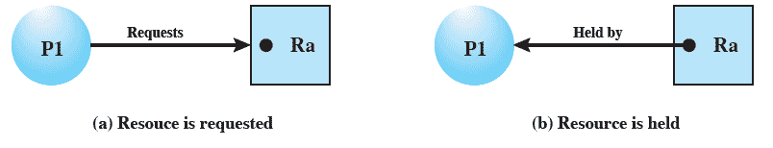
Resource Allocation
Graphs
Directed graph that depicts a state of the system of resources and processes
Notes:
A graph edge directed from a process to a resource indicates a resource that has been requested by the process but not yet granted.
Within a resource node, a dot is shown for each instance of that resource.
A graph edge directed from a reusable resource node dot to a process indicates a request that has been granted
100

Slide 101
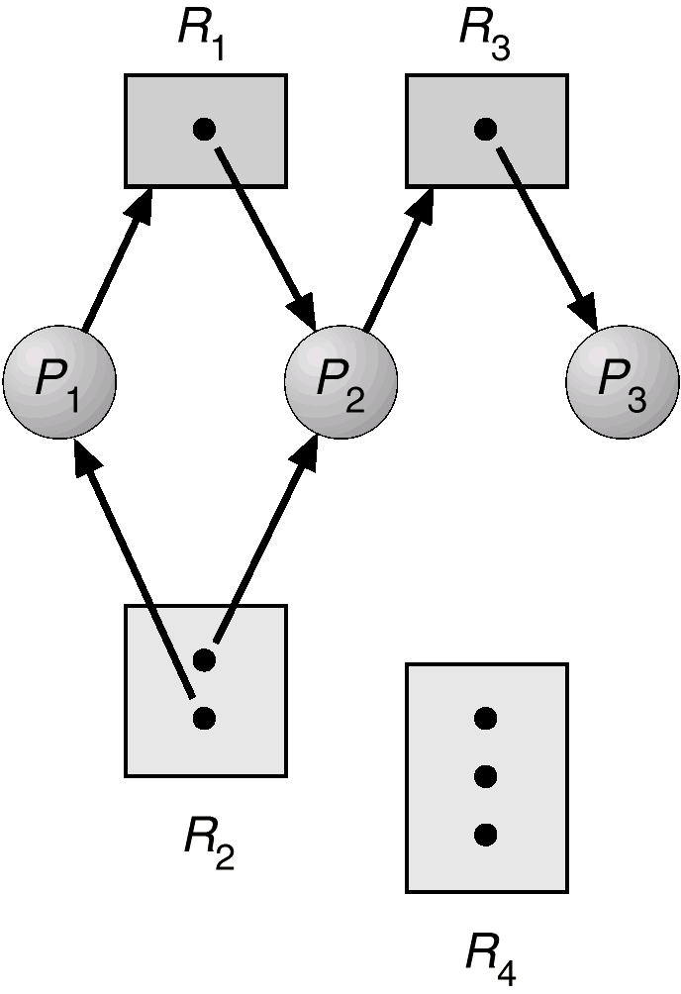
Example of a Resource Allocation Graph

Slide 102
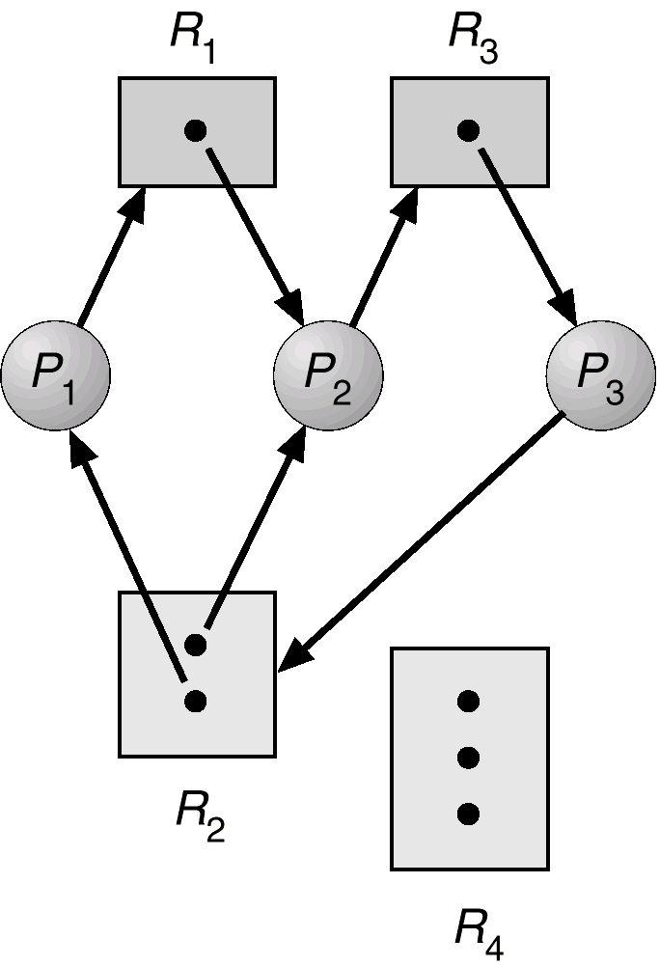
Resource Allocation Graph With A Deadlock

Slide 103
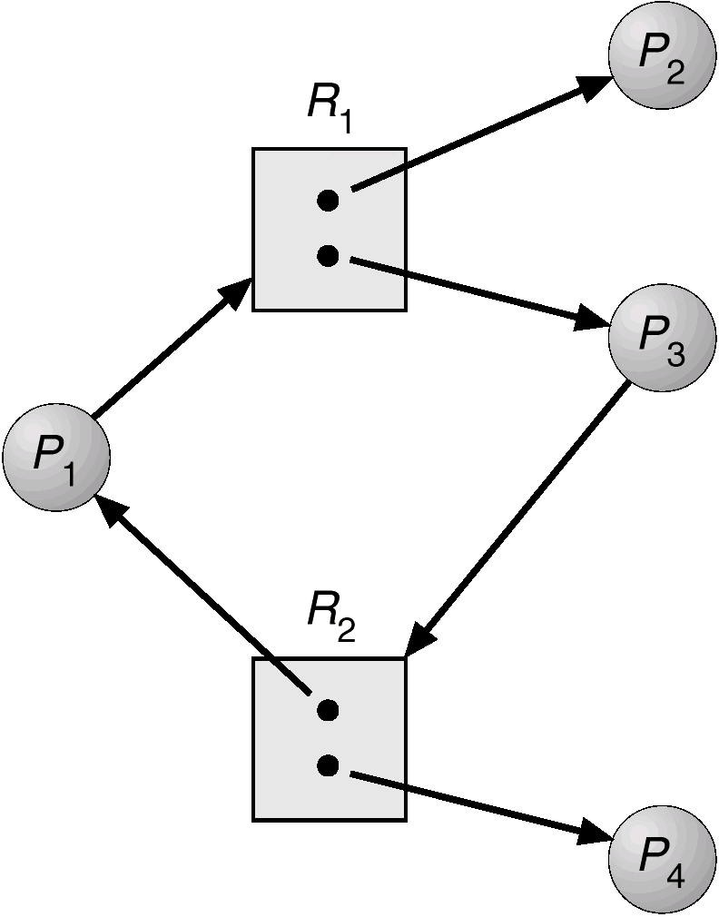
Resource Allocation Graph With A Cycle But No Deadlock

Slide 104
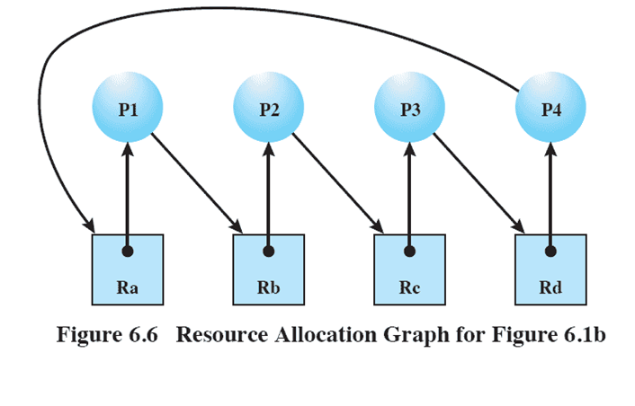
Resource Allocation
Graphs
Notes:
104

Slide 105
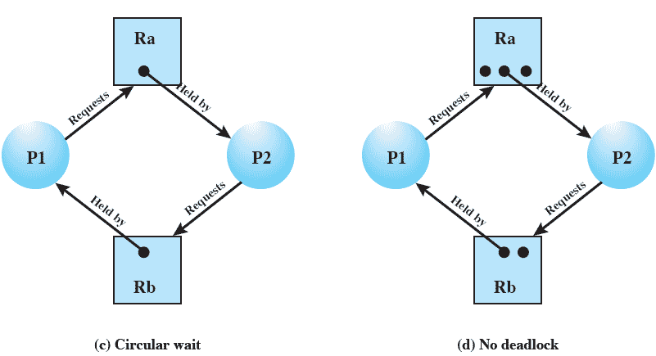
Resource Allocation
Graphs of deadlock
Notes:
105

Slide 106
Basic Facts
If graph contains no cycles ⇒ no deadlock.
If graph contains a cycle ⇒
  if only one instance per resource type, then deadlock.
  if several instances per resource type, possibility of deadlock.

Slide 107
Methods for Handling Deadlocks
Ensure that the system will never enter a deadlock state.( Protocol for Deadlock prevention or a deadlock Avoidance )
Allow the system to enter a deadlock state, Detect it and then recover.
Ignore the problem (Ostrich Technique )and pretend that deadlocks never occur in the system; used by most operating systems, including UNIX.

Slide 108
Deadlock Prevention Strategy
Design a system in such a way that the possibility of deadlock is excluded.
Two main methods
  Indirect – prevent all three of the necessary conditions occurring at once
  Direct – prevent circular waits
Notes:
Deadlock prevention is strategy simply to design a system in such a way that the possibility of deadlock is excluded.
We can view deadlock prevention methods as falling into two classes.
indirect method of deadlock prevention is to prevent the occurrence of one of the three necessary conditions listed previously (items 1 through 3).
direct method of deadlock prevention is to prevent the occurrence of a circular wait (item 4).
We now examine techniques related to each of the four
conditions.
108

Slide 109
Deadlock Prevention
Restrain the ways request can be made. ( Ensure that at least one of these conditions cannot hold )
Mutual Exclusion – not required for sharable resources; must hold for nonsharable resources.
Hold and Wait – must guarantee that whenever a process requests a resource, it does not hold any other resources.
  Require process to request and be allocated all its resources before it begins execution, or allow process to request resources only when the process has none.
  Low resource utilization; starvation possible.

Slide 110
Deadlock Prevention (Cont.)
No Preemption –
  If a process that is holding some resources requests another resource that cannot be immediately allocated to it, then all resources currently being held are released.
  Preempted resources are added to the list of resources for which the process is waiting.
  Process will be restarted only when it can regain its old resources, as well as the new ones that it is requesting.
Circular Wait – impose a total ordering of all resource types, and require that each process requests resources in an increasing order of enumeration.

Slide 111
Deadlock Avoidance
Requires that the system has some additional a priori information
available.
Simplest and most useful model requires that each process declare the maximum number of resources of each type that it may need.
The deadlock-avoidance algorithm dynamically examines the resource-allocation state to ensure that there can never be a circular-wait condition.
Resource-allocation state is defined by the number of available and allocated resources, and the maximum demands of the processes.

Slide 112
Safe State
When a process requests an available resource, system must decide if immediate allocation leaves the system in a safe state.
System is in safe state if there exists a safe sequence of all processes.
Sequence <P₁, P₂, …, P_{n}> is safe if for each P_{i}, the resources that Pi can still request can be satisfied by currently available resources + resources held by all the P_{j}, with j<I.
  If P_{i} resource needs are not immediately available, then P_{i} can wait until all P_{j} have finished.
  When P_{j} is finished, P_{i} can obtain needed resources, execute, return allocated resources, and terminate.
  When P_{i} terminates, P_{i+1} can obtain its needed resources, and so on.

Slide 113
Basic Facts
If a system is in safe state ⇒ no deadlocks.
If a system is in unsafe state ⇒ possibility of deadlock.
Avoidance ⇒ ensure that a system will never enter an unsafe state.

Slide 114
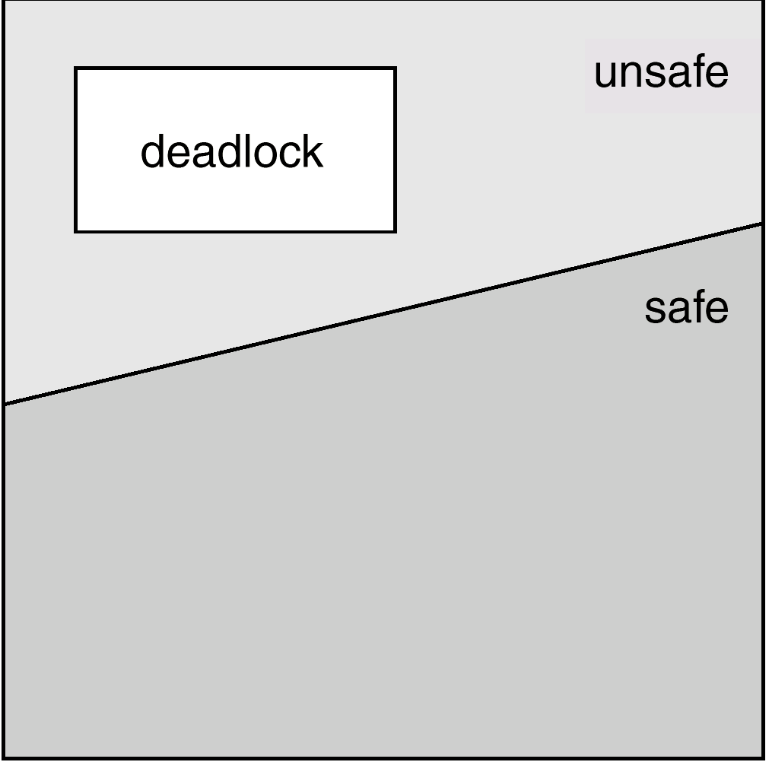
Safe, Unsafe , Deadlock State

Slide 115
Resource-Allocation Graph Algorithm
Claim edge P_{i} → R_{j} indicated that process P_{j} may request resource R_{j}; represented by a dashed line.
Claim edge converts to request edge when a process requests a resource.
When a resource is released by a process, assignment edge reconverts to a claim edge.
Resources must be claimed a priori in the system.

Slide 116
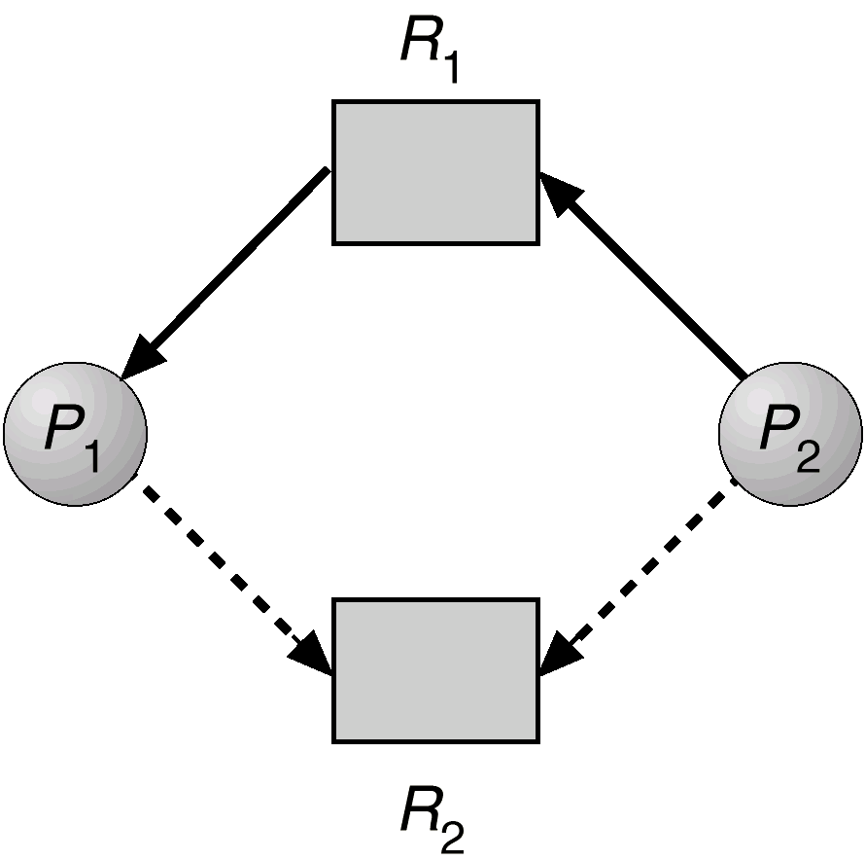
Resource-Allocation Graph For Deadlock Avoidance

Slide 117
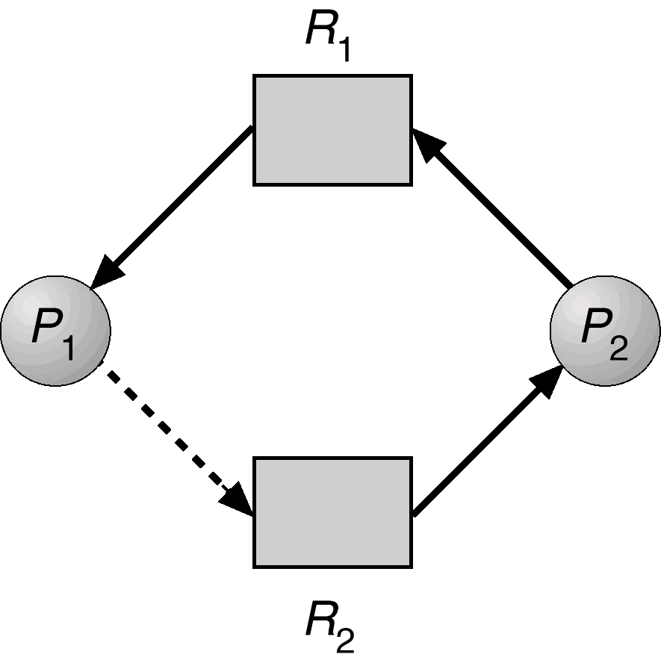
Unsafe State In Resource-Allocation Graph

Slide 118
Two Approaches to Deadlock Avoidance
Process Initiation Denial
  Do not start a process if its demands might lead to deadlock
Resource Allocation Denial
  Do not grant an incremental resource request to a process if this allocation might lead to deadlock
Notes:
118

Slide 119
Process Initiation Denial
A process is only started if the maximum claim of all current processes plus those of the new process can be met.
Not optimal,
  Assumes the worst: that all processes will make their maximum claims together.
Notes:
A process is only started if the maximum claim of all current processes plus those of the new process can be met.
This strategy is hardly optimal, because it assumes the worst:
that all processes will make their maximum claims together.
119

Slide 120
Resource
Allocation Denial
Referred to as the banker’s algorithm
  A strategy of resource allocation denial
Consider a system with fixed number of resources
  State of the system is the current allocation of resources to process
  Safe state is where there is at least one sequence that does not result in deadlock
  Unsafe state is a state that is not safe
Notes:
Movie button goes to http://gaia.ecs.csus.edu/~zhangd/oscal/Banker/Banker.html
120

Slide 121
Banker’s Algorithm
Multiple instances.
Each process must a priori claim maximum use.
When a process requests a resource it may have to wait.
When a process gets all its resources it must return them in a finite amount of time.

Slide 122
Application:
Banker's Algorithm name was chosen because this algorithm could be used in banking system to ensure that bank should not run out of cash (resources).
So, bank never allocates its available cash in such a way that it can no longer satisfy the needs of all its customers.
Using Banker's algorithm Banks ensures that when customers need cash (resources), algorithm will determine whether allocation of cash will leave Bank in safe state or not.
If it will cash are allocated, otherwise customer must wait until some another customer deposit enough cash.

Slide 123
State of the current allocation of resources
Resource = R = (R₁, R₂, … R_{m}) | Total amount of each recourse on the system
Available=V= (V₁, V₂, … V_{m}) | Total amount of each resource not allotted to any process
C₁₁ C₁₂ … C_{1m} C₂₁ C₂₂ … C_{2m} C₃₁ C₃₂ … C_{3m} Claim = C = C₄₁ C₄₂ … C_{4m} … C_{n1} C_{n2} … C_{nm} | Cij = requirement of process i for resource j
A₁₁ A₁₂ … A_{1m} A₂₁ A₂₂ … A_{2m} A₃₁ A₃₂ … A_{3m} Allocation= A = A₄₁ A₄₂ … A_{4m} … A_{n1} A_{n2} … A_{nm} | Aij = current allocation to process i for resource j
Notes:
123

Slide 124
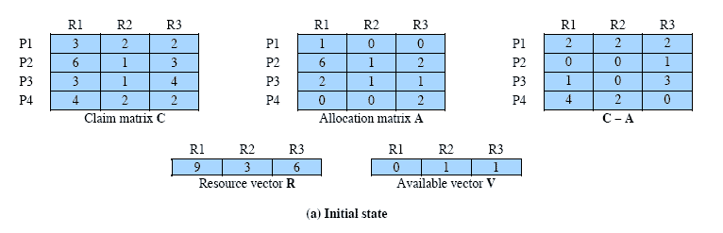
Determination of
Safe State ( Example: 1)
A system consisting of four processes and three resources.
Allocations are made to processors
Is this a safe state?:
Resources available after allocation
Amount of Existing Resources
Can any of the 4 processes run to completion with resources available?
Notes:
Animation: Callouts explain resource parts of figure
This figure shows the state of a system consisting of four processes and three resources.
Total amount of resources
R1 = 9
R2 = 3
R3 = 6
In the current state allocations have been made to the four processes, leaving available
1 unit of R2
1 unit of R3
Is this a safe state?
To answer this question, we ask an intermediate question:
Can any of the four processes be run to completion with the resources available?
That is, can the difference between the maximum requirement and current allocation for any process be met with the available resources?
124

Slide 125
Process i
C_{ij} - A_{ij} ≤ V_{j}, for all j
This is not possible for P1,
  which has only 1 unit of R1 and requires 2 more units of R1, 2 units of R2, and 2 units of R3.
If we assign one unit of R3 to process P2,
  Then P2 has its maximum required resources allocated and can run to completion and return resources to ‘available’ pool

Slide 126
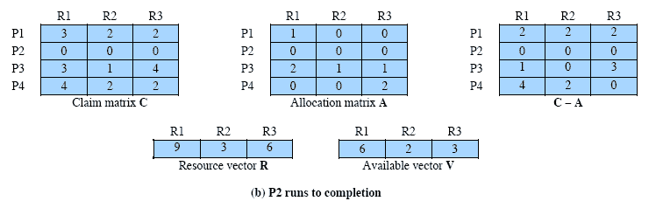
After P2 runs to completion
Can any of the remaining processes can be completed?
Note P2 is completed
Notes:
In this case, each of the remaining processes could be completed as shown on the next slides
126

Slide 127
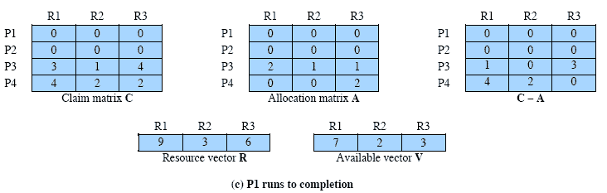
After P1 completes
Notes:
Suppose we choose P1,
allocate the required resources,
complete P1,
and return all of P1’s resources to the available pool.
We are left in the state shown in Figure 6.7c on this slide
127

Slide 128
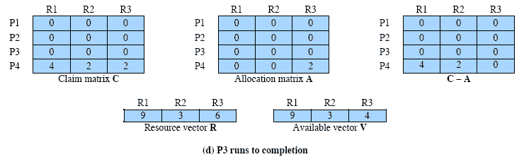
P3 Completes
Thus, the state defined originally is a safe state.
Notes:
P3 completes, resulting in the state of Figure 6.7d shown on this slide
Finally, we can complete P4. At this point, all of the processes have been run to completion.
Thus, the state defined by Figure 6.7a is a safe state.
128

Slide 129
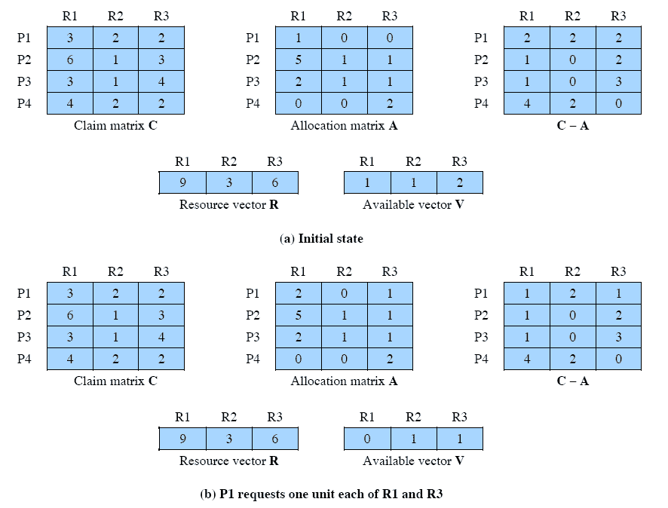
Determination of an
Unsafe State
This time Suppose that P1 makes the request for one additional unit each of R1 and R3.
Is this safe?
Notes:
Suppose that P1 makes the request for one additional unit each of R1 and R3; if we assume that the request is granted,
Is this a safe state?
No,
because each process will need at least one additional unit of R1, and there are none available.
Thus, on the basis of deadlock avoidance, the request by P1 should be denied and P1 should be blocked.
NOTE: This is not a deadlocked state.
It merely has the potential for deadlock.
It is possible, for example, that if P1 were run from this state it would subsequently release one unit of R1 and one unit of R3 prior to needing these resources again.
If that happened, the system would return to a safe state.
Thus, the deadlock avoidance strategy does not predict deadlock with certainty; it merely anticipates the possibility of deadlock and assures that there is never such a possibility.
129

Slide 130
Deadlock Avoidance
When a process makes a request for a set of resources,
  assume that the request is granted,
  Update the system state accordingly,
Then determine if the result is a safe state.
  If so, grant the request and,
  if not, block the process until it is safe to grant the request.
Notes:
This suggests the following deadlock avoidance strategy,
which ensures that the system of processes and resources is always in a safe state.
When a process makes a request for a set of resources, assume that the request is granted, update
the system state accordingly, and then determine if the result is a safe state. If so,
grant the request and, if not, block the process until it is safe to grant the request.
130

Slide 131
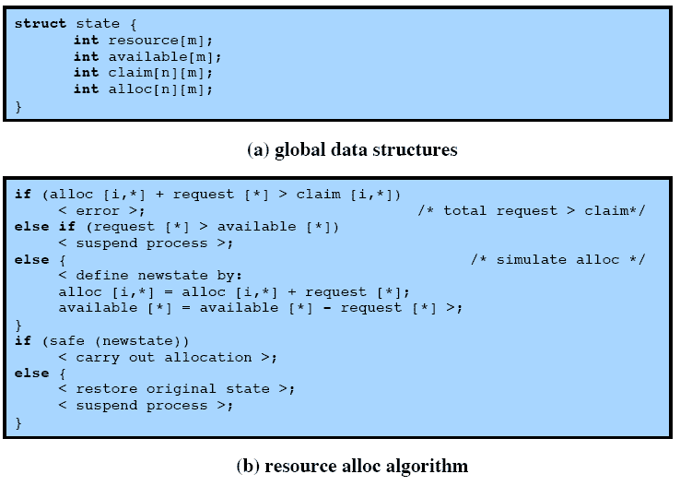
Deadlock Avoidance
Logic
Notes:
This slide gives an abstract version of the deadlock avoidance logic.
The main algorithm is shown in part (b).
With the state of the system defined by the data structure state, request[*] is a vector defining the resources requested by process i.
First, a check is made to assure that the request does not exceed the original claim of the process.
If the request is valid, the next step is to determine if it is possible to fulfill the request (i.e., there are sufficient resources available).
If it is not possible, then the process is suspended.
If it is possible, the final step is to determine if it is safe to fulfill the request. To do this, the resources are tentatively assigned to process i to form newstate.
131

Slide 132
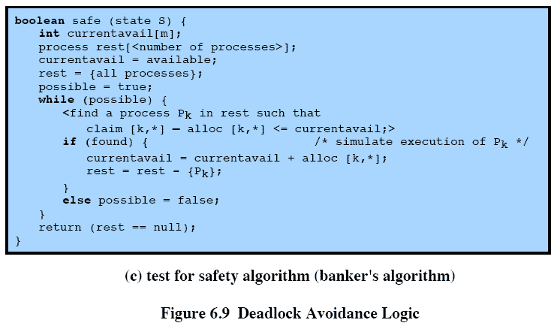
Deadlock Avoidance
Logic
Notes:
Then a test for safety is made using the algorithm in Figure 6.9c.
132

Slide 133
Deadlock Avoidance Advantages
It is not necessary to preempt and rollback processes, as in deadlock detection,
It is less restrictive than deadlock prevention.
Notes:
Deadlock avoidance has the advantage that it is not necessary to preempt and
rollback processes, as in deadlock detection, and is less restrictive than deadlock
prevention.
133

Slide 134
Deadlock Avoidance Restrictions
Maximum resource requirement must be stated in advance
Processes under consideration must be independent and with no synchronization requirements
There must be a fixed number of resources to allocate
No process may exit while holding resources
Notes:
However, it does have a number of restrictions on its use:
• The maximum resource requirement for each process must be stated in advance.
• The processes under consideration must be independent;
that is, the order in which they execute must be unconstrained by any synchronization requirements.
• There must be a fixed number of resources to allocate.
• No process may exit while holding resources.
134

Slide 135
Data Structures for the Banker’s Algorithm
Let n = number of processes, and m = number of resources types.
Available: Vector of length m. If available [j] = k, there are k instances of resource type R_{j} available.
Max: n x m matrix. If Max [i,j] = k, then process P_{i} may request at most k instances of resource type R_{j}.
Allocation: n x m matrix. If Allocation[i,j] = k then P_{i} is currently allocated k instances of R_{j.}
Need: n x m matrix. If Need[i,j] = k, then P_{i} may need k more instances of R_{j} to complete its task.
    Need [i,j] = Max[i,j] – Allocation [i,j].

Slide 136
Safety Algorithm
1. Let Work and Finish be vectors of length m and n, respectively. Initialize:
      Work = Available
      Finish [i] = false for i - 1,3, …, n.
2. Find and i such that both:
  (a) Finish [i] = false
  (b) Need_{i} ≤ Work
  If no such i exists, go to step 4.
3. Work = Work + Allocation_{i}
Finish[i] = true
go to step 2.
4. If Finish [i] == true for all i, then the system is in a safe state.

Slide 137
Resource-Request Algorithm for Process P_{i}
Request = request vector for process P_{i}. If Request_{i} [j] = k then process P_{i} wants k instances of resource type R_{j.}
  1. If Request_{i} ≤ Need_{i} go to step 2. Otherwise, raise error condition, since process has exceeded its maximum claim.
  2. If Request_{i} ≤ Available, go to step 3. Otherwise P_{i} must wait, since resources are not available.
  3. Pretend to allocate requested resources to P_{i} by modifying the state as follows:
      Available = Available = Request_{i};
      Allocation_{i} = Allocation_{i} + Request_{i};
      Need_{i} = Need_{i} – Request_{i;;}
    If safe ⇒ the resources are allocated to P_{i}.
    If unsafe ⇒ P_{i} must wait, and the old resource-allocation state is restored

Slide 138
Banker’s Algorithm
5 processes P₀ through P₄; 3 resource types A
(10 instances),
B (5instances, and C (7 instances).
Snapshot at time T₀:
Allocation Max Available
A B C A B C A B C
P₀ 0 1 0 7 5 3 3 3 2
P₁ 2 0 0 3 2 2
P₂ 3 0 2 9 0 2
P₃ 2 1 1 2 2 2
P₄ 0 0 2 4 3 3

Slide 139
Example (Cont.)
The content of the matrix. Need is defined to be Max – Allocation.
Need
A B C
P₀ 7 4 3
P₁ 1 2 2
P₂ 6 0 0
P₃ 0 1 1
P₄ 4 3 1
The system is in a safe state since the sequence < P₁, P₃, P₄, P₂, P₀> satisfies safety criteria.

Slide 140
Example P₁ Request (1,0,2) (Cont.)
Check that Request ≤ Available (that is, (1,0,2) ≤ (3,3,2) ⇒ true.
Allocation Need Available
A B C A B C A B C
P₀ 0 1 0 7 4 3 2 3 0
P₁ 3 0 2 0 2 0
P₂ 3 0 1 6 0 0
P₃ 2 1 1 0 1 1
P₄ 0 0 2 4 3 1
Executing safety algorithm shows that sequence <P₁, P₃, P₄, P₀, P₂> satisfies safety requirement.
Can request for (3,3,0) by P₄ be granted?
Can request for (0,2,0) by P₀ be granted?

Slide 141
Deadlock Detection
Allow system to enter deadlock state
Detection algorithm
Recovery scheme

Slide 142
Single Instance of Each Resource Type
Maintain wait-for graph
  Nodes are processes.
  P_{i} → P_{j} if P_{i} is waiting for P_{j}.
Periodically invoke an algorithm that searches for a cycle in the graph.
An algorithm to detect a cycle in a graph requires an order of n² operations, where n is the number of vertices in the graph.

Slide 143
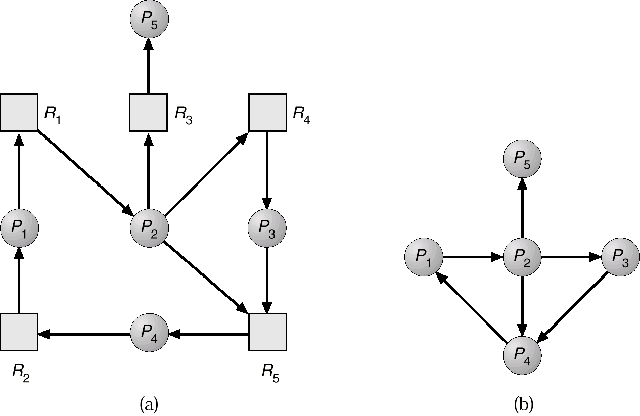
Resource-Allocation Graph and Wait-for Graph
Resource-Allocation Graph
Corresponding wait-for graph

Slide 144
Several Instances of a Resource Type
Available: A vector of length m indicates the number of available resources of each type.
Allocation: An n x m matrix defines the number of resources of each type currently allocated to each process.
Request: An n x m matrix indicates the current request of each process. If Request [i_{j}] = k, then process P_{i} is requesting k more instances of resource type. R_{j}.

Slide 145
Detection Algorithm
1. Let Work and Finish be vectors of length m and n, respectively Initialize:
  (a) Work = Available
  (b) For i = 1,2, …, n, if Allocation_{i} ≠ 0, then
  Finish[i] = false;otherwise, Finish[i] = true.
2. Find an index i such that both:
  (a) Finish[i] == false
  (b) Request_{i} ≤ Work
  If no such i exists, go to step 4.

Slide 146
Detection Algorithm (Cont.)
3. Work = Work + Allocation_{i}
Finish[i] = true
go to step 2.
4. If Finish[i] == false, for some i, 1 ≤ i ≤ n, then the system is in deadlock state. Moreover, if Finish[i] == false, then P_{i} is deadlocked.
Algorithm requires an order of O(m x n²⁾ operations to detect whether the system is in deadlocked state.

Slide 147
Example of Detection Algorithm
Five processes P₀ through P₄; three resource types
A (7 instances), B (2 instances), and C (6 instances).
Snapshot at time T₀:
Allocation Request Available
A B C A B C A B C
P₀ 0 1 0 0 0 0 0 0 0
P₁ 2 0 0 2 0 2
P₂ 3 0 3 0 0 0
P₃ 2 1 1 1 0 0
P₄ 0 0 2 0 0 2
Sequence <P₀, P₂, P₃, P₁, P₄> will result in Finish[i] = true for all i.

Slide 148
Example (Cont.)
P₂ requests an additional instance of type C.
Request
A B C
P₀ 0 0 0
P₁ 2 0 1
P₂ 0 0 1
P₃ 1 0 0
P₄ 0 0 2
State of system?
  Can reclaim resources held by process P₀, but insufficient resources to fulfill other processes; requests.
  Deadlock exists, consisting of processes P₁, P₂, P₃, and P₄.

Slide 149
Detection-Algorithm Usage
When, and how often, to invoke depends on:
  How often a deadlock is likely to occur?
  How many processes will need to be rolled back?
    one for each disjoint cycle
If detection algorithm is invoked arbitrarily, there may be many cycles in the resource graph and so we would not be able to tell which of the many deadlocked processes “caused” the deadlock.

Slide 150
Recovery from Deadlock: Process Termination
Abort all deadlocked processes.
Abort one process at a time until the deadlock cycle is eliminated.
In which order should we choose to abort?
  Priority of the process.
  How long process has computed, and how much longer to completion.
  Resources the process has used.
  Resources process needs to complete.
  How many processes will need to be terminated.
  Is process interactive or batch?

Slide 151
Recovery from Deadlock: Resource Preemption
Selecting a victim – minimize cost.
Rollback – return to some safe state, restart process for that state.
Starvation – same process may always be picked as victim, include number of rollback in cost factor.

Slide 152
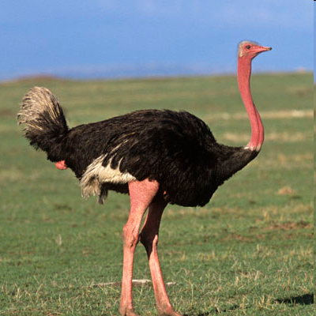

Deadlock Ignorance( Ostrich Technique)

Slide 153
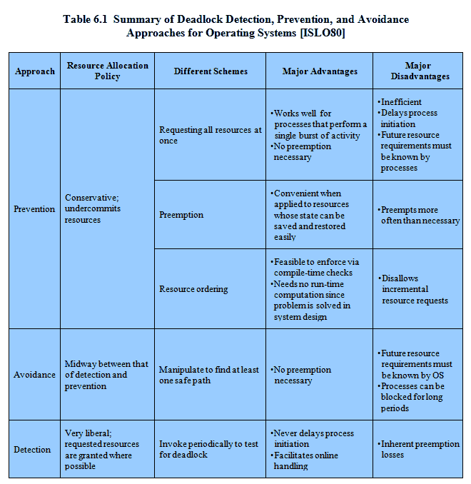
Advantages and Disadvantages
Notes:
There are strengths and weaknesses to all of the strategies for dealing with deadlock.
Rather than attempting to design an OS facility that employs only one of these strategies, it might be more efficient to use different strategies in different situations.
153

Slide 154
Combined Approach to Deadlock Handling
Combine the three basic approaches
  prevention
  avoidance
  detection
allowing the use of the optimal approach for each of resources in the system.
Partition resources into hierarchically ordered classes.
Use most appropriate technique for handling deadlocks within each class.

Slide 155
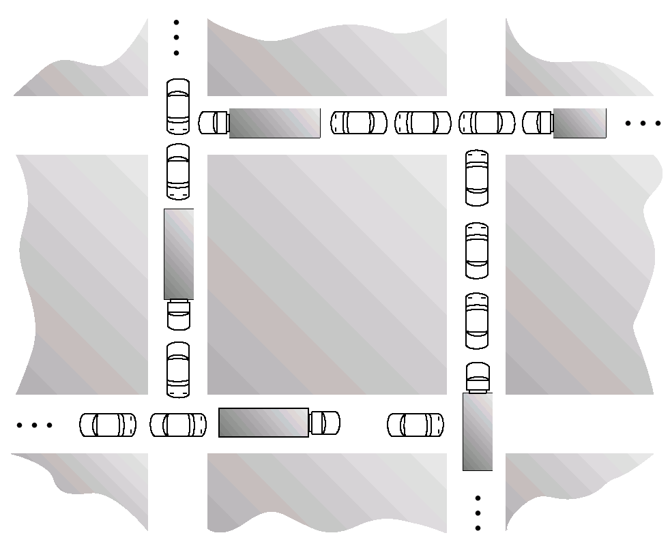
Traffic Deadlock for Exercise

Slide 156
Thank you

